Slide 1

Methodology: Data Analysis and Presentation
AEPSY Year 11 ATAR Psychology

Slide 2
Review
List the 8 ethical considerations for human research.
Explain the differences between longitudinal and cross sectional studies (include benefits and limitations)
Define Demand Characteristics
Give one example for each:
a) qualitative data
b) quantitative data
c) objective physiological data
5. Draw a diagram to represent snowball sampling

Slide 3
protection from harm – physical and psychological
informed consent
withdrawal rights
deception
confidentiality
privacy
voluntary participation
debriefing

Slide 4
Learning Intentions
Processing and analysing data
construct and interpret data displays
graphs – scatterplot, bar, column, line, histogram
tables – summary, frequency
calculate and interpret the mean and median as measures of central tendency
interpret Pearson’s correlation coefficient as a measure of strength and direction of linear relationships

Slide 5
Success Criteria
Select appropriate graph type for different data sets
Distinguish between summary and frequency tables
Calculate mean and median
Use Pearson’s correlation coefficient to describe relationships between IV and DV

Slide 6
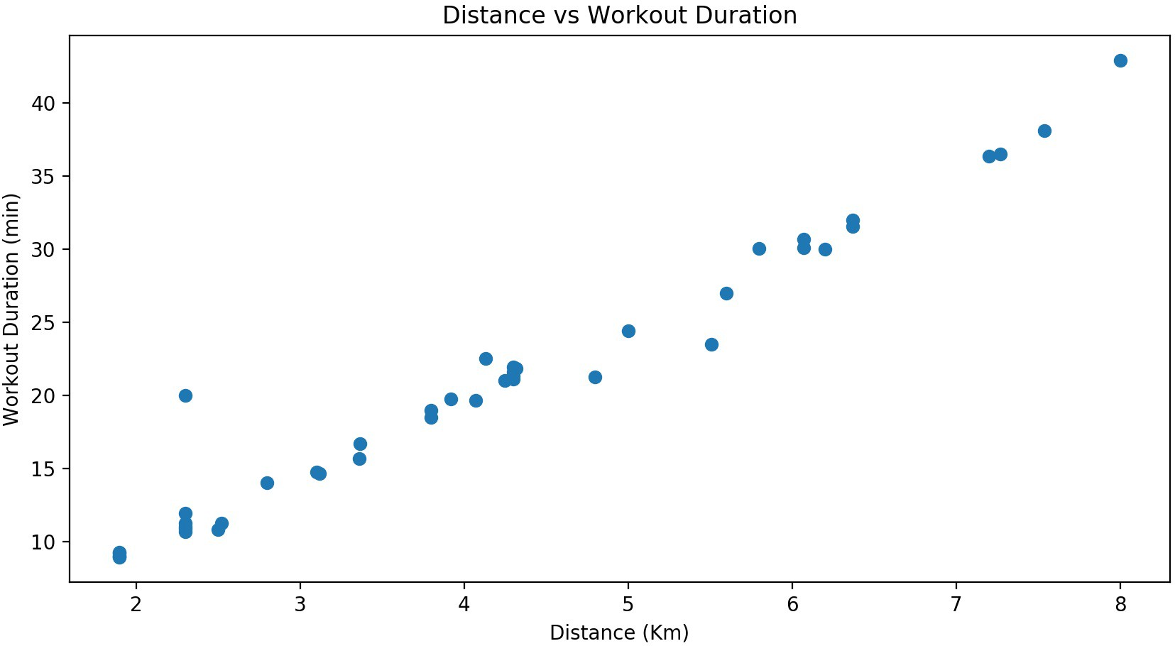
Graphs: Scatterplot
Used with correlations where the relationship of two variables is summarised. They illustrate the direction of the relationship (positive, negative or zero correlation) and can indicate the potential strength of the relationship.

Slide 7
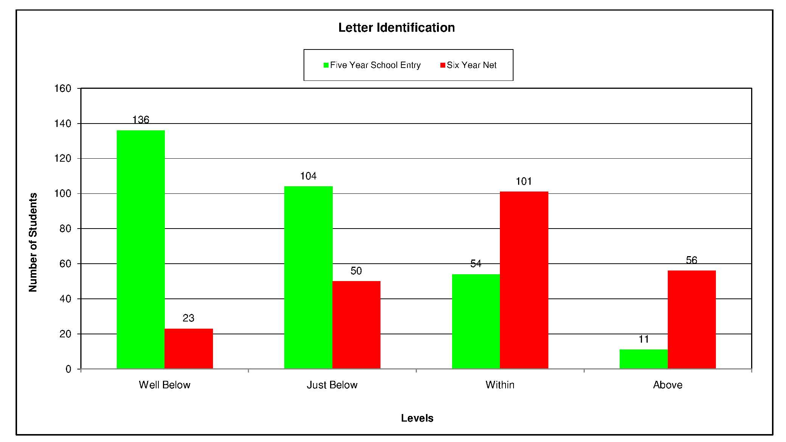
Graphs: Bar or column
Represent the data from tally charts, mean scores or the totals. They are used with nominal or ordinal levels of measurement. The bars/columns must be separate from each other.

Slide 8
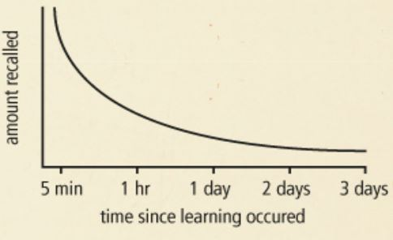
Graphs: Line
Also used with continuous/interval data; do not need to have equal sized intervals of data on the x axis. IV will be on the x axis and the DV on the y axis.

Slide 9
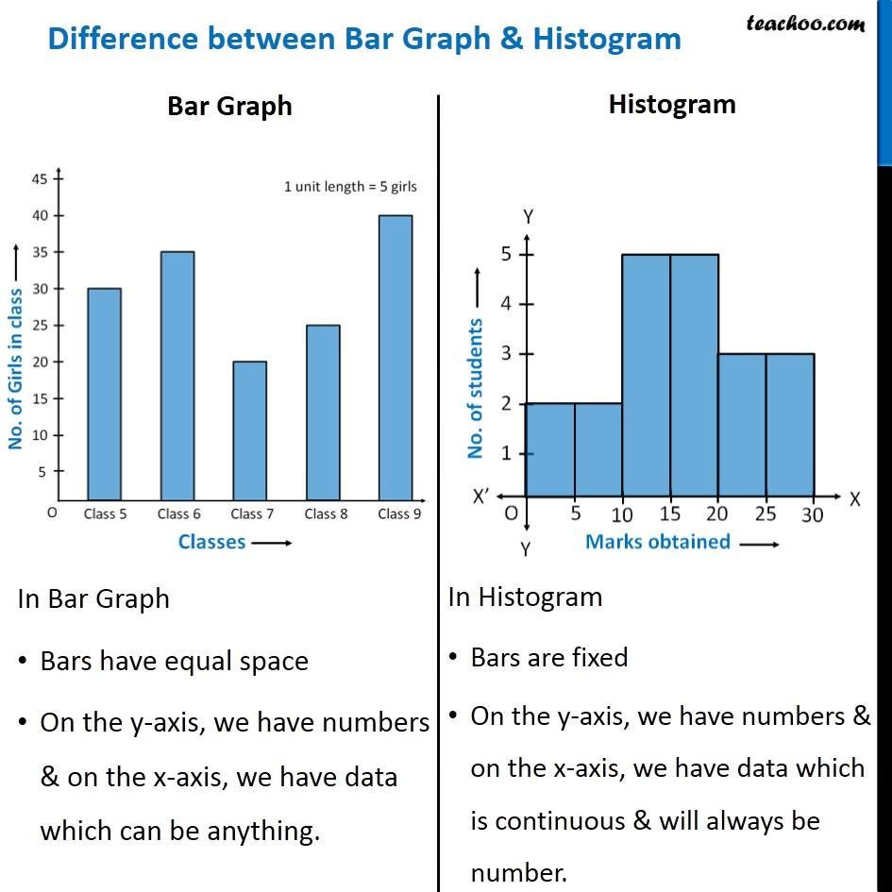
Graphs: Histograms
Present continuous/interval data such as weight, height and temperature; have no gaps between the bars; always have equal sized intervals of data on the x axis, and the y axis always represents the frequency within each interval.

Slide 10
Tables: Summary
A summary table uses groups and statistics to transform your raw data into a more accessible format.
Calculate counts and statistics—including sum, average, minimum, maximum, median, and percentile.

Slide 11
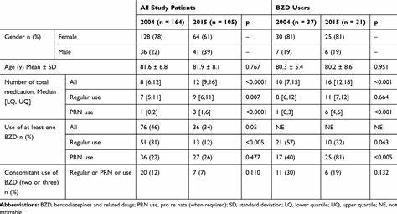

Slide 12
Table: Frequency
Analyze the way the data is distributed across different values. Frequency means the number of times a value appears in the data.

Slide 13
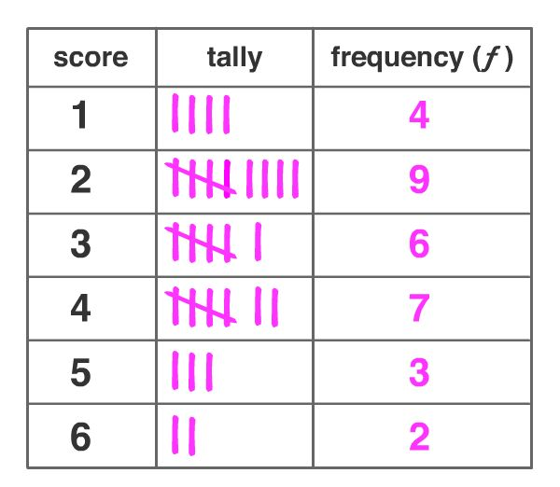

Slide 14
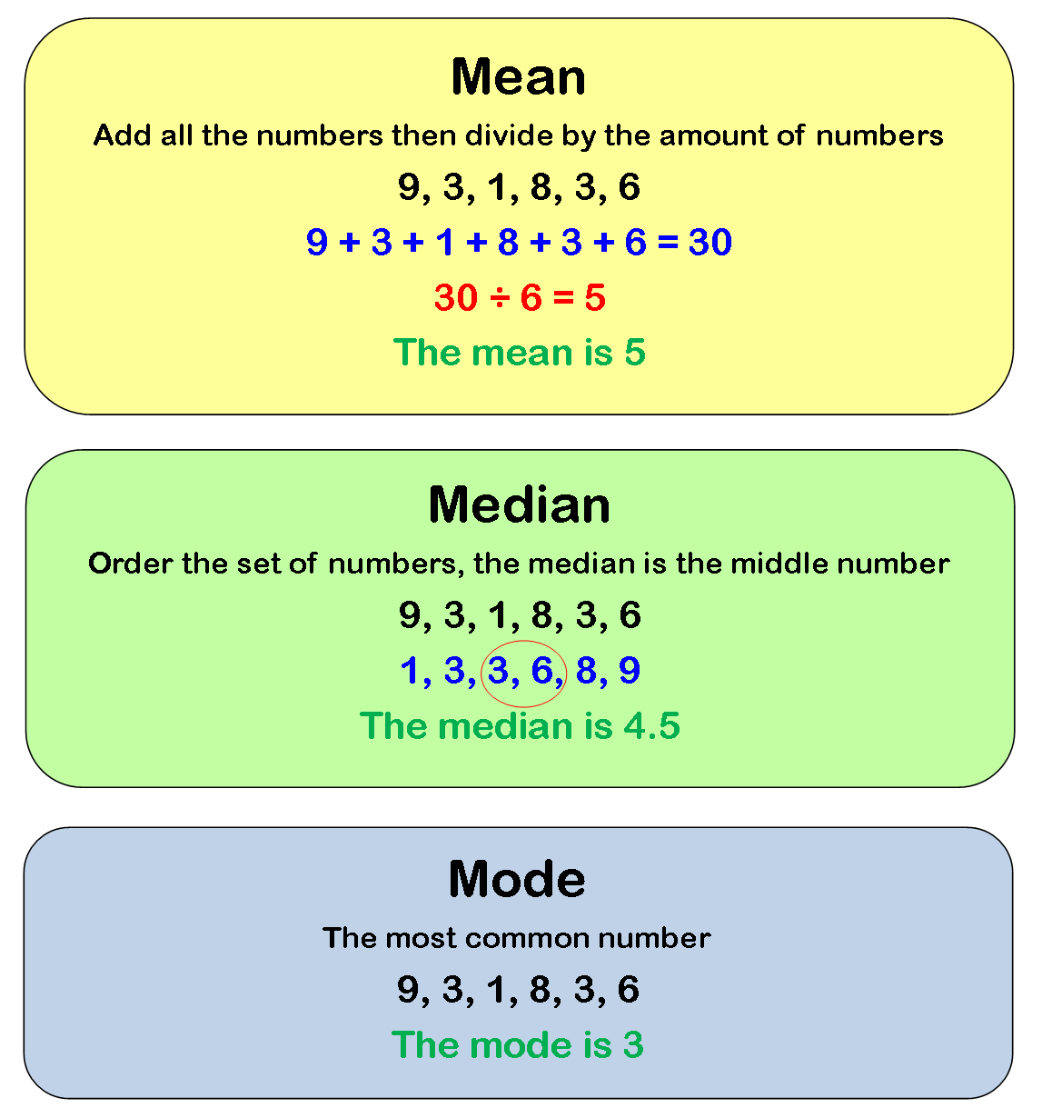
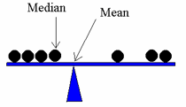
Central tendency: Mean and median
Mean is the average of a certain number of items in a data set
Median is the middlemost value in a given data set.

Slide 15
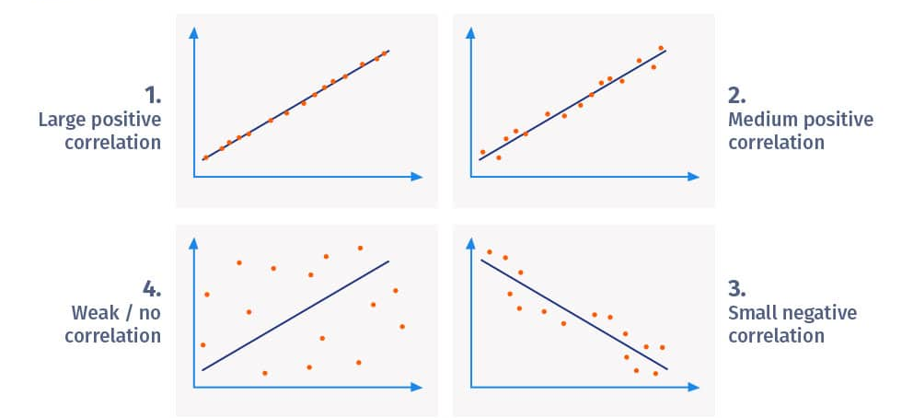
Pearson’s correlation coefficient

Slide 16
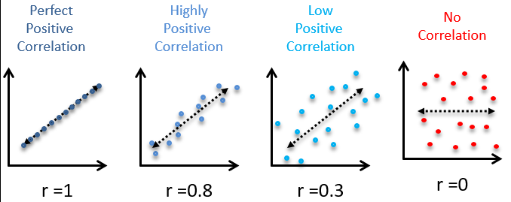
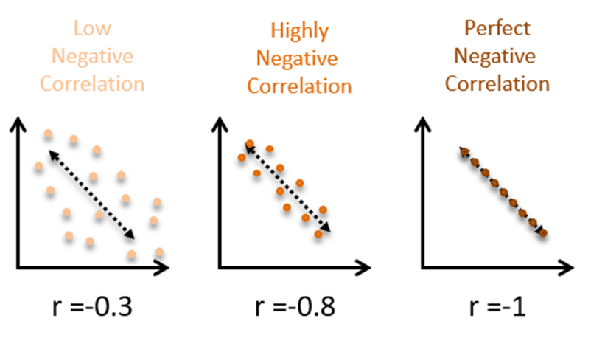

Slide 17
Success Criteria
Select appropriate graph type for different data sets
Distinguish between summary and frequency tables
Calculate mean and median
Use Pearson’s correlation coefficient to describe relationships between IV and DV

